Slide 1
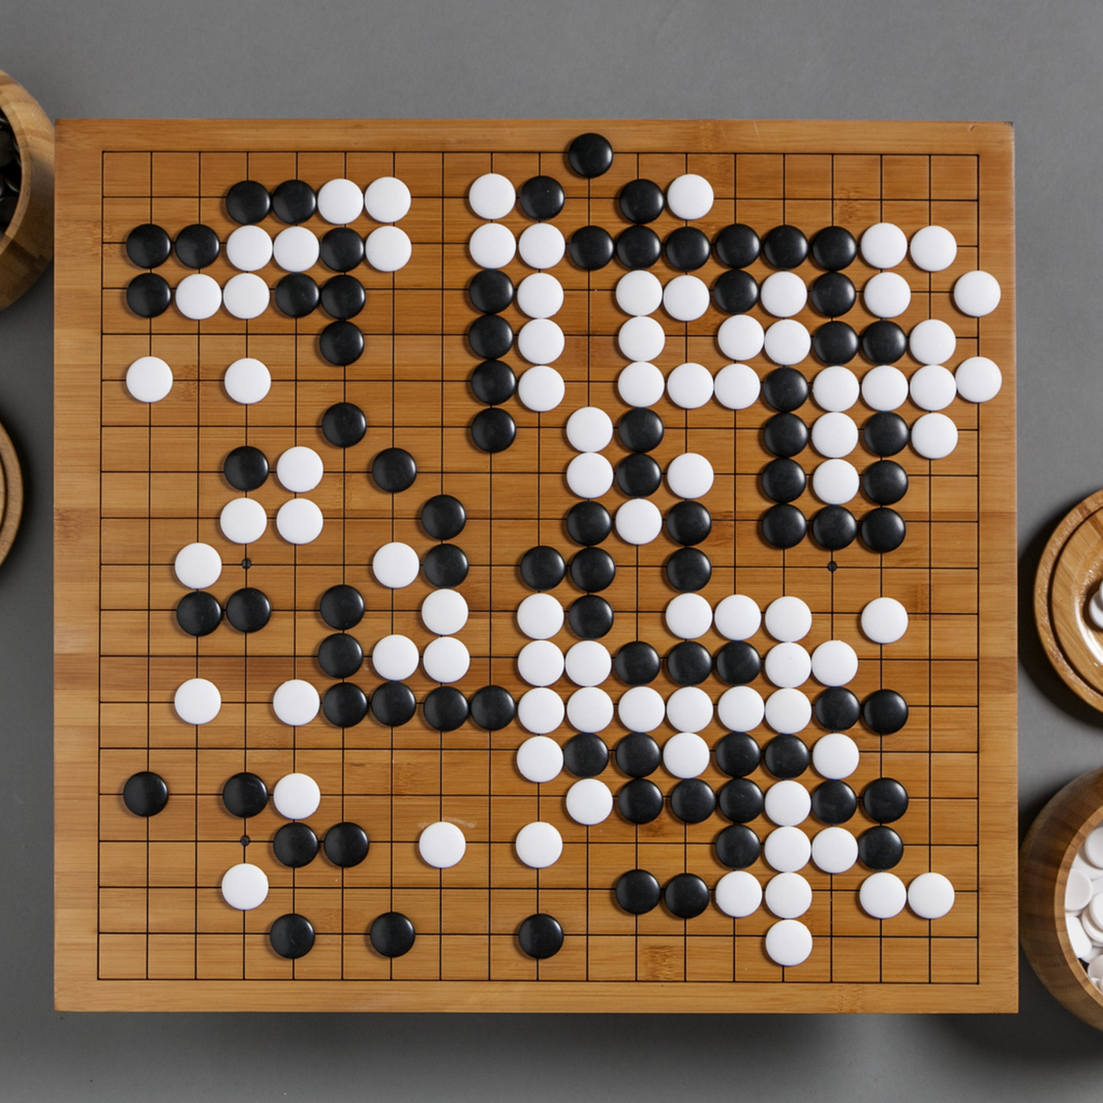
CSCI 599: ZeroGo
Solving the game of Go with ML
Final presentation
Sunny Patel
Jing Ouyang
Wesam Alwehaibi

Slide 2
Introduction and Recap

Slide 3

Introduction Video

Slide 4
Recap: What is Go?
Invented in China 2500 years ago, is the oldest board game played today
2 players with the goal of surrounding opponent’s chess with their own
Rules:
Liberty Rule: Every stone must have a Liberty(open point) or belong to a group that has a liberty
KO rule: Stones do not repeat their positions

Slide 5

Recap: Why is Go interesting for CSCI 599?
Google acquired DeepMind at $500M which built AlphaGo that beat Lee Sedol
“AlphaGo is the first computer program to defeat a professional human Go player, the first to defeat a Go world champion, and is arguably the strongest Go player in history”
Alphago Requirements:
Needs 4+ TPUs or 200+ GPUs
Needed 5+ years to complete!
500 times the depth of the game tree of Chess
130,000 “possible next moves” after first 2 turns (Chess has 400)

Slide 6
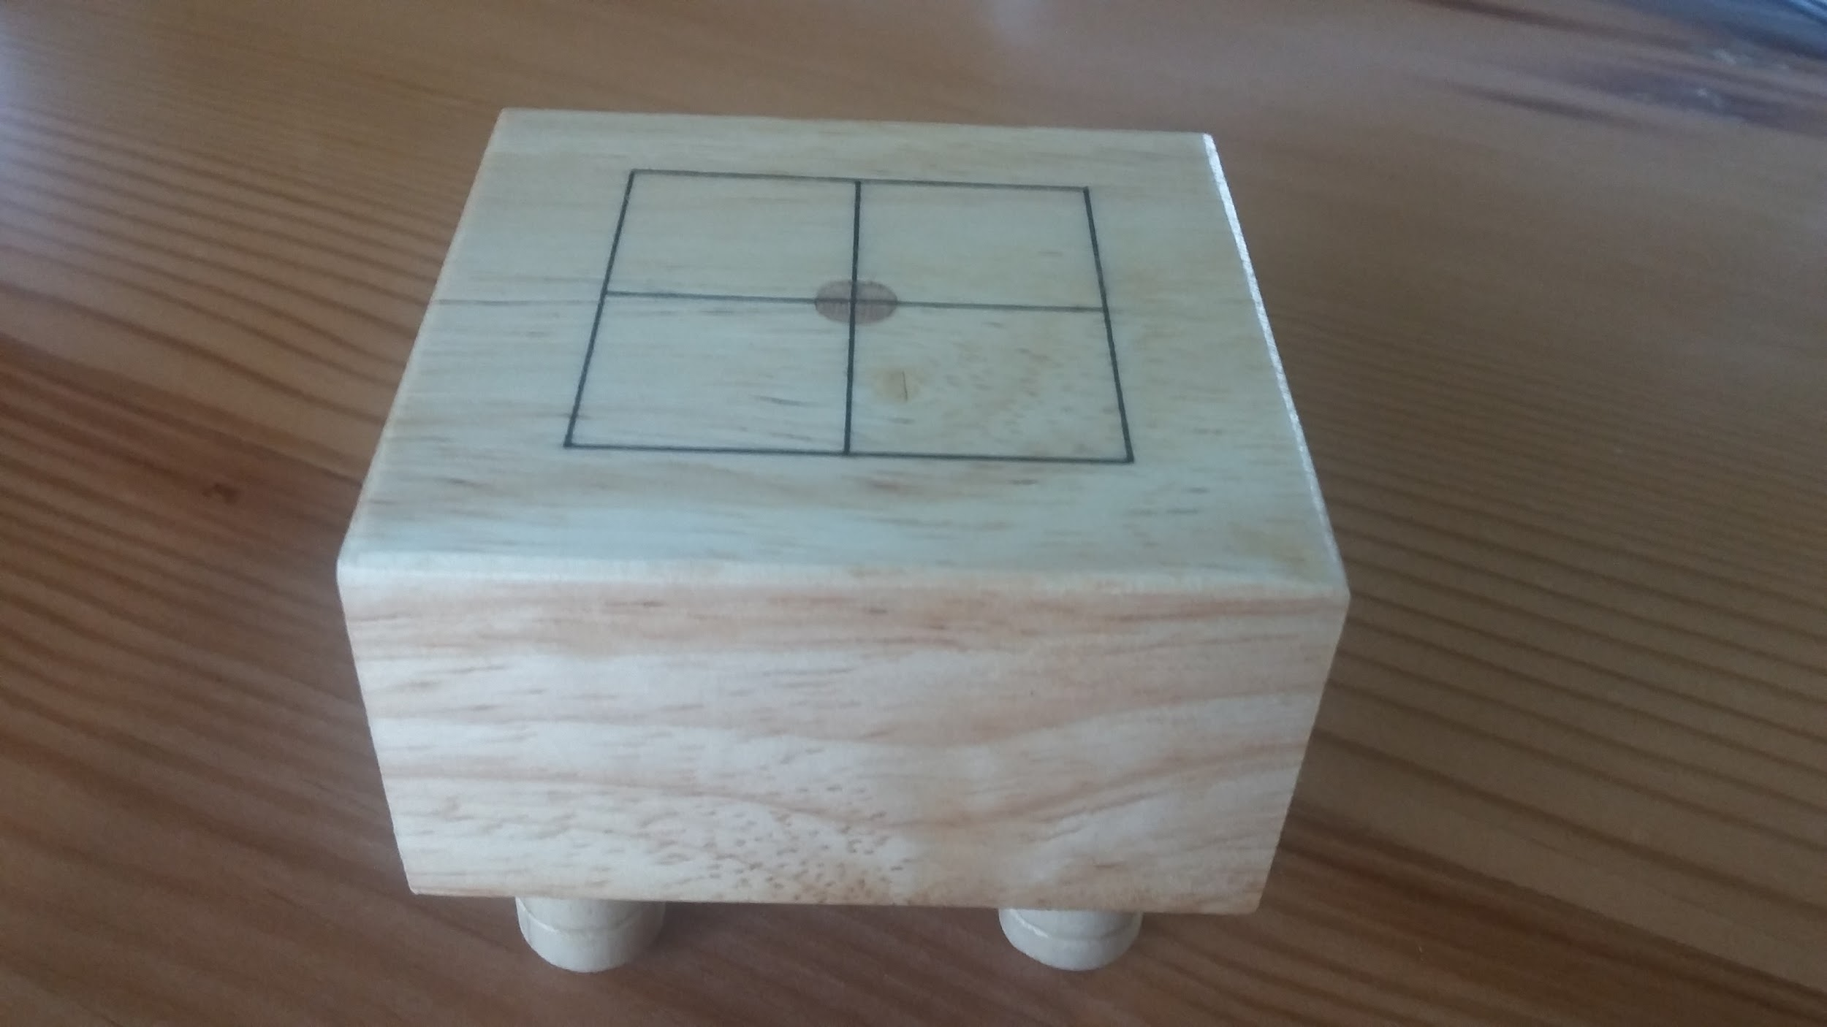
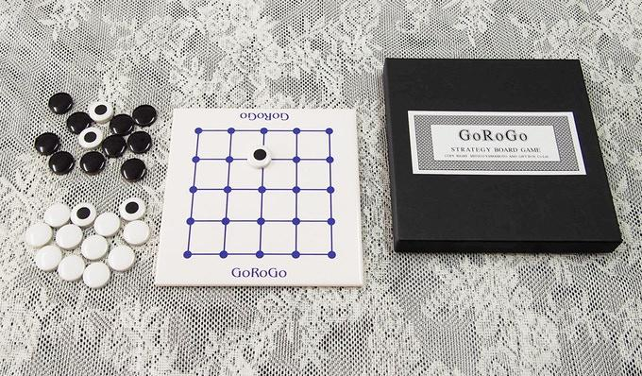
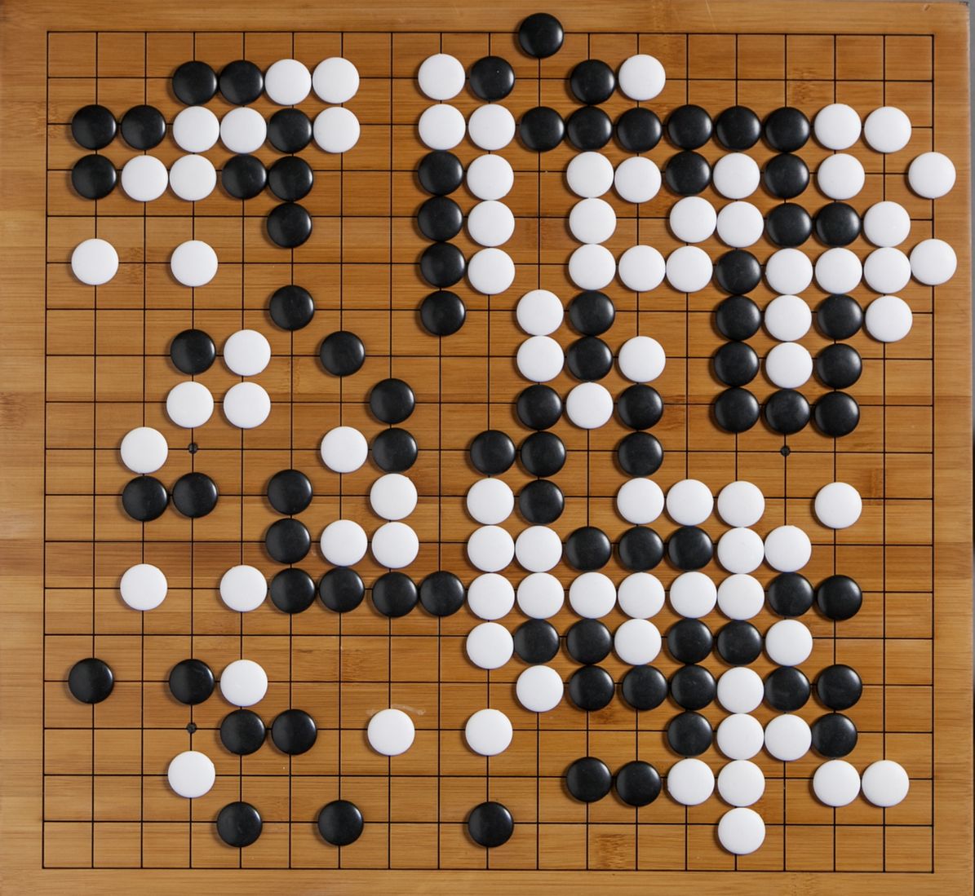
Recap: Why is Go interesting for CSCI 599?
3x3 Board
12000 valid states
5x5 Board
414,295,148,741 valid states
19x19 Board
2.08168199382 x 10¹⁷⁰ valid states

Slide 7
Implementations: Naive - Random, Greedy

Slide 8
Implementations:
Search Based - Minimax, AlphaBeta, MCTS

Slide 9
Implementations: ML Based - Neural Network, Actor Critic

Slide 10
Implementations: ZeroGo - our original model for Go!

Slide 11
ZeroGo components
Monte-Carlo Tree Search
Read ahead
Policy Agent
Provide instincts to select a move
Value Agent
Judge board position
Rollout
Explore long-term variation
U-value
Q-value-1
Q-value-2

Slide 12
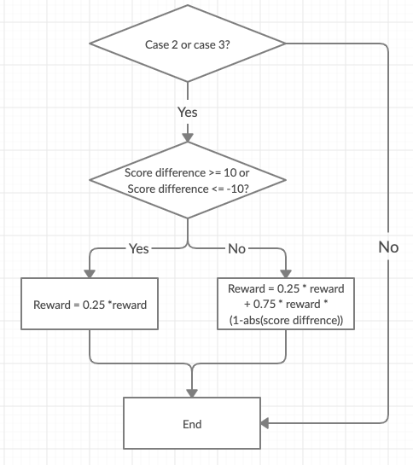
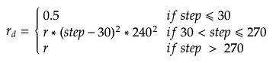
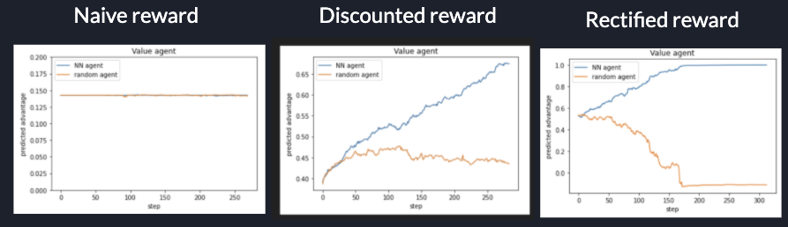
ZeroGo Innovations
Hand-tailored reward function
Compensate the limited computing power
Takes only 2000 games training to reach decent power

Slide 13
ZeroGo Innovations
Automated-training cycle
Continuously learning given enough computational power
Step 1
Self-play
Step 4
Step 2
Update
Train
Step 3
Evaluate

Slide 14
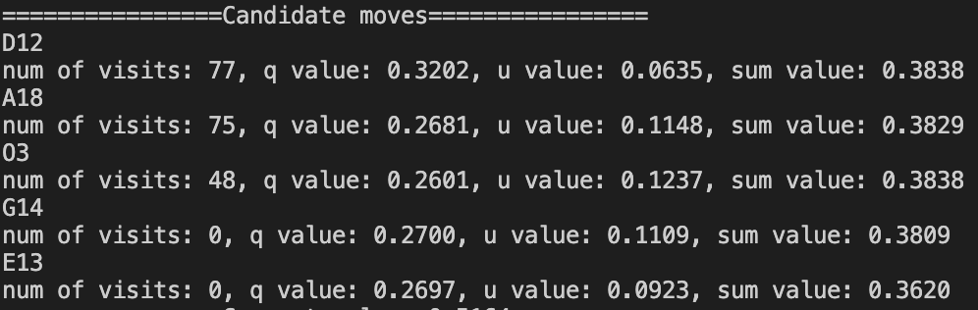
ZeroGo Innovations
Multiple advantages
Trade off between instincts and long-term reward
Visualize thinking process
Judge living and dead groups
Set resign threshold
Flexible to show different levels of strength by setting the parameters

Slide 15
Demo

Slide 16
Conclusion

Slide 17
Goals/Ideas: Proposed
Goal 1: Answer “how far can we go with a normal hardware or $500M?”
A smaller board size?
Real board with lesser win %?
Goal 2: Devise smarter algorithms
Can’t run Q-Learning with 10¹⁷⁰ states.
Deep Q-Learning? Deep Neural Networks? MCTS?
Goal 3: Build less sophisticated players/other online players to benchmark
Greedy heuristics?
Interview players to see what strategies they use?

Slide 18
Goals: Outcome of Goal 1
Answer “how far can we go with a normal hardware”
5X5 and 7X7 near unbeatable solutions!
19X19 a 1-dan player which:
A human takes 1 year to reach
Was not achieved by a traditional player
Notes:
Looking ahead, for the next 3 weeks -
we plan to implement more things
-add more algorithms and train current models more.
Work on actor critic and alphago and ZEROGO impl

Slide 19
Goals: Outcome of Goal 2
Devise smarter algorithms
A smarter model for Alpha Go
Combined NN with Reinforcement
Implement heuristics adopted by real Go players
Our player is a 1-dan player which:
Takes 1-year of gameplay for a human
Never achieved by a traditional algorithm

Slide 20
Goals: Outcome of Goal 3
Build less sophisticated players to benchmark
Greedy, Random, Naive agents help mimic a mature players and explore new states
Tested agents against a real player
Benchmarked ZeroGo to be X dan!

Slide 21
Goals: Notable achievements
Contribute to an AlphaGo dependency on Github!
Implemented a custom model for AlphaGo
Beat claims by X % without using expensive h/w
More than 6 agents of varying skill
Best player ranking: X dan!
All this, on our MacBook Pros!

Slide 22
Thanks!

